Slide 1


NPDES Toxicity Testing: Statewide Toxicity Provisions and the
Ceriodaphnia dubia Study
Paul Bedore and Cameron Irvine
2023 Annual Conference

Slide 2


Overview
Anticipated changes to NPDES permits due to Statewide Toxicity Provisions
Statewide Ceriodaphnia dubia special study update

Slide 3
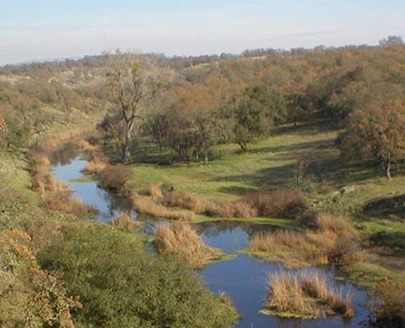

Statewide Toxicity Provisions
 New Policy – Effective May 1, 2023
 Added to NPDES permit at renewal
 Consistent Requirements
Numeric effluent limitations or targets – acute and chronic
Reasonable Potential Analysis
Monitoring – Routine & follow- up
Test of Significant Toxicity (TST)
Sensitive test species
Toxicity Reduction Evaluations (TREs)

Slide 4
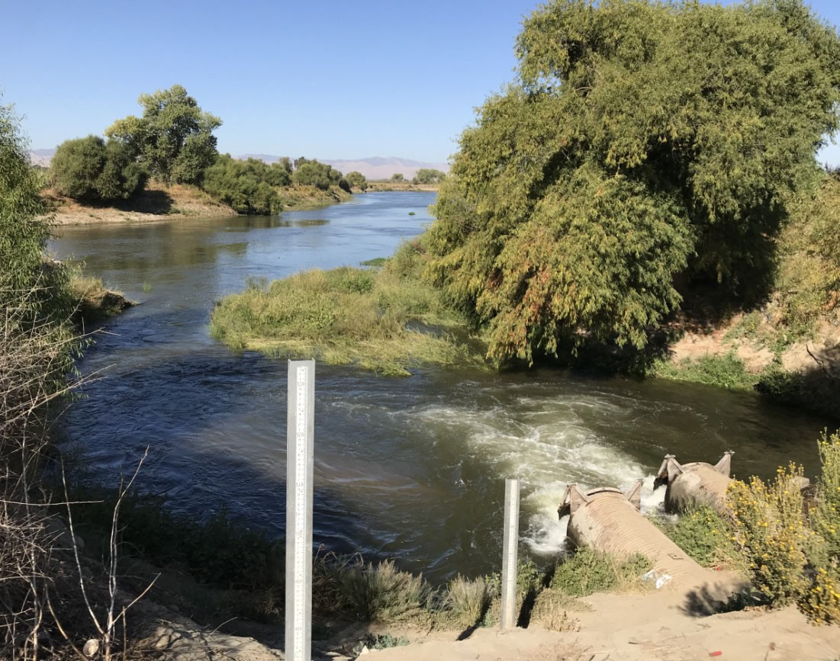
Basic Concepts
Instream Waste Concentration (IWC), Test Species, TST
IWC = % Effluent used for compliance tests & effluent limits/targets
100% for effluent-dominated
< 100% if dilution available
Dilution study
Regional Water Board issue in NPDES permit
Test with most Sensitive Species
Test of Significant Toxicity (TST) = New Statistical Analysis
PASS or FAIL outcome

Slide 5


Reasonable Potential Analysis (RPA)
Will you get an effluent limit?
 Acute Toxicity –
Regional Board Discretion
Can forego RPA & Effluent Limits
 Chronic Toxicity –
Authorized Flow ≥ 5 mgd & Industrial Pretreatment Program (IPP)
Effluent Limits automatically issued
All Others:
Authorized Flow < 5 mgd or no IPP
Effluent Limits are issued if in past 5 years, any test*…
“FAILs” TST or
Exceeded 10% effect
*Tests conducted at the IWC using most sensitive species

Slide 6
Chronic Toxicity Effluent Limits
Two (2) effluent limits are issued to those with RPA
 MDEL - Maximum Daily Effluent Limit
No test* may exhibit ≥ 50% effect survival endpoint
Applies to C. dubia & fathead minnow
Green alga test species -
Use “growth” endpoint
 MMEL - Median Monthly Effluent Limit
Only one test* in a month may “FAIL” TST
If routine test FAILs → Conduct two follow-up tests in same month
*Test conducted at the IWC using most sensitive species

Slide 7

Chronic Toxicity “Targets”
Dischargers without reasonable potential for chronic toxicity
“Targets” for triggering TREs
MDET - Max Daily Effluent “Target”
MMET - Median Monthly Effluent “Target”
Same values as MDEL & MMELs
Exceedance ≠ permit violation
No Acute Toxicity Targets

Slide 8
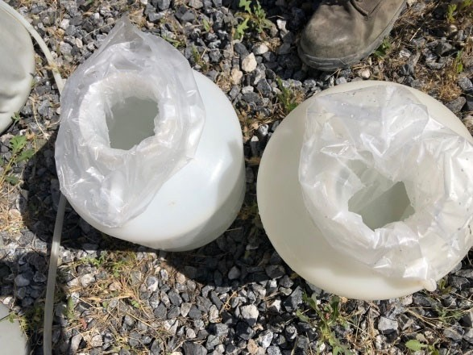
Routine Monitoring
Dischargers with Effluent Limits
Acute testing – Minimum Chronic testing frequency of 1/year
Authorized Flow (mgd) | Routine Monitoring Frequency
≥ 5 | Monthly
>1 & < 5 | Quarterly
≤ 1 | Two per year
Exceptions / Special Cases
  Dischargers qualifying for reduced monitoring
  Intermittent discharges

Slide 9
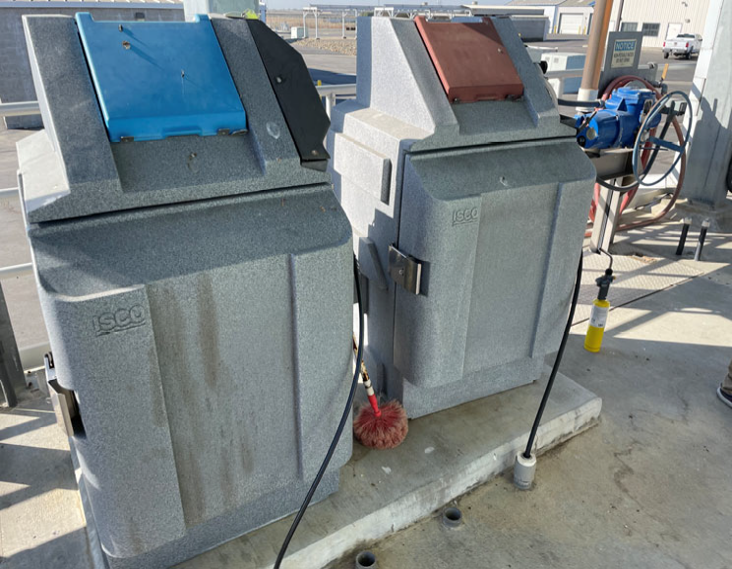
Routine Monitoring
Dischargers without Effluent Limits
Chronic toxicity monitoring
Authorized Flow (mgd) | Routine Monitoring Frequency
All | Minimum, 2 per year
Dischargers with no acute toxicity limits
No acute tox monitoring required

Slide 10

Extra Required Monitoring
If the routine test = “FAIL” of TST
 “MMEL” or “MMET” tests
2 additional tests following “FAIL” of TST in routine test
Initiated in same month
2nd MMEL test not required if 1st MMEL test “FAIL”
Prepare:
  Anticipate MMEL sampling
  Test @ 1st of month (if routine testing is monthly)
  Timely notifications from lab

Slide 11
MMEL/MMET Testing Example
Chronic Ceriodaphnia dubia test
Sunday | Monday | Tuesday | Wednes. | Thursday | Friday | Saturday
 |  | 1 | 2 | 3 Routin | 4 e Test | 5
6 | 7 | 8 | 9 | 10 | 11 | 12
13 | 14 | 15 | 16 MM | 17 EL Test #1 | 18 | 19
20 | 21 | 22 | 23 MM | 24 EL Test | 25 #2 | 26
27 | 28 | 29 | 30
 Month start day specified in permit
 Test initiation = day
1st sample collected
 C. dubia test – 3 brood / 8 day (max)
Start next routine test

Slide 12

Assessing Exceedances for a Month
Effluent Limitations & Targets
Routine Test | MMEL Test #1 | MMEL Test #2 | MMEL Exceedance | MDEL Exceedance
Pass | -- | -- | No | No
Fail | Pass | Pass | No | Yes - if FAIL & ≥ 50% effect to survival**
Fail | Pass | Fail | Yes
Fail | Fail | -- | Yes
MMEL – Median Monthly Effluent Limit MMET – Median Monthly Effluent Target
**or growth for the green alga species

Slide 13
Toxicity Reduction Evaluation
Identify & Correct Cause of Toxicity
 TRE required if:
 Two (2) exceedances of limits or targets
 in the same or consecutive months
If routine monitoring is 1/quarter or 2/year, POTW must monitor again in Month 2 if one (1) exceedance in Month 1
Month 1 |  | Month 2
No. of Exceedances | TRE Triggered? | No. of Exceedances | TRE Triggered?
0 | No | -- | --
1 (MDEL or MMEL) | Monitor in Month 2 to Determine | 0 | No
 |  | 1 or more | Yes TRE Triggered
2 (MDEL & MMEL) | Yes TRE Triggered | -- | --
13

Slide 14
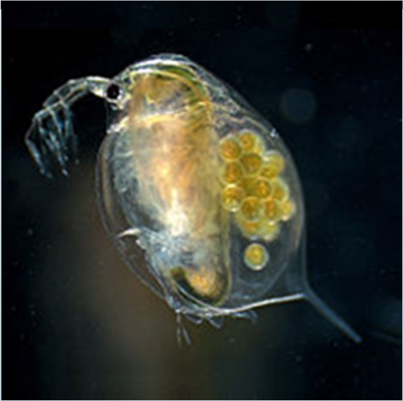
State Water Board
Ceriodaphnia dubia Special Study

Slide 15
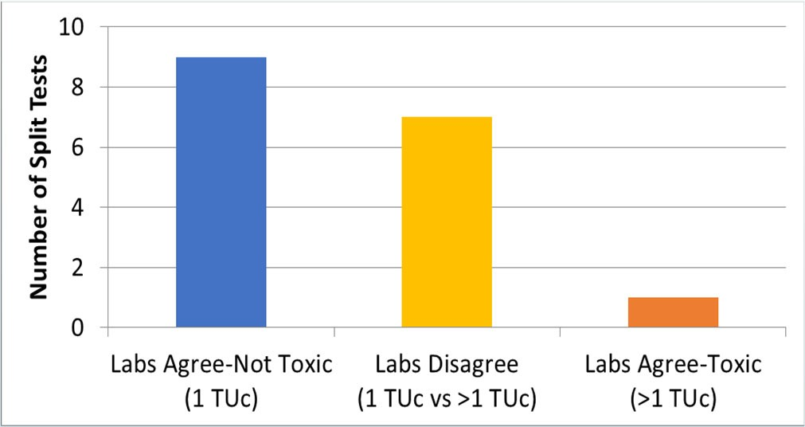

C. dubia Chronic Toxicity Special Study
7 of 17 split samples had different results at 2 different labs
Stakeholder Concerns
Consistency and reproducibility
State Water Board
Delay C. dubia MMEL through December 31, 2023
Conduct a study
Study Goal
Investigate sources of test variability
Develop guidance to improve test consistency/comparability
TUc: Chronic Toxic Units = 100 / No Observed Effect Concentration
Source: California discharger dataset of 17 effluent toxicity tests with split samples submitted to different ELAP accredited laboratories (data from CVCWA 2018). https://www.waterboards.ca.gov/water_issues/programs/state_i mplementation_policy/docs/comments20181221/debbie_webster
.pdf

Slide 16

C. dubia Chronic Toxicity Special Study
Led by SCCWRP & initiated December 2020
Expert Scientist Committee (ESC)
Stakeholder Advisory Committee (SAC)
POTW stakeholder on SAC
Funding interlaboratory comparison testing

Slide 17

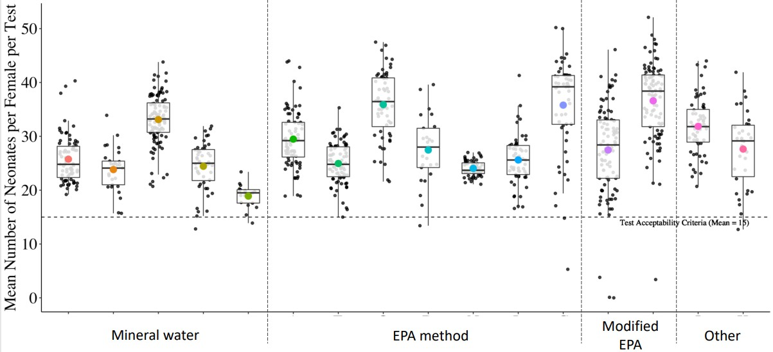
Statewide Chronic C. dubia Special Study
Phases
istorical data analysis – 16 labs
- No strong causes of variability
First round of interlaboratory comparison testing – blank and reference toxicant samples
  No strong causes of variability
  Laboratory visits / training
Second round of interlab comparison testing
Product – Laboratory best practices (Summer 2023)
H
Mean neonates per female per test
Ceriodaphnia control reproduction in 2 years of testing at 16 CA labs
Source: https://www.sccwrp.org/about/research-areas/additional- research-areas/ceriodaphnia-toxicity-testing-quality-assurance/

Slide 18
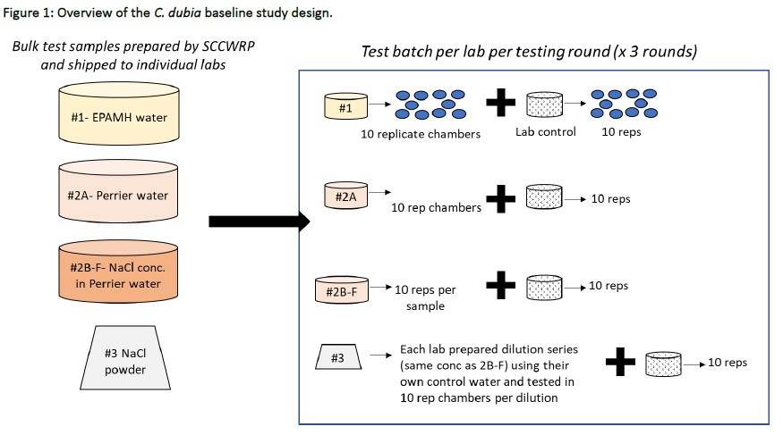

Statewide Chronic C. dubia Special Study
Phases
istorical data analysis – 16 labs
No strong causes of variability
irst round of interlaboratory comparison testing – blank and reference toxicant samples
No strong causes of variability
Laboratory visits / training
Second round of interlab comparison testing
Product – Laboratory best practices (Summer 2023)
H
F
Mean neonates per female per test
Ceriodaphnia control reproduction in 2 years of testing at 16 CA labs
Source: https://www.sccwrp.org/about/research-areas/additional- research-areas/ceriodaphnia-toxicity-testing-quality-assurance/
18

Slide 19

Questions?
Paul Bedore, M.S.
Director of Wastewater and Stormwater Regulatory Services
paul@robertson-bryan.com / (916) 405-8918
Cameron Irvine, M.S.
Senior Environmental Scientist / Ecotoxicologist cam@robertson-bryan.com / (916) 714-1805

